Slide 1
Boozeless in SG
How Boozeless can take its first step in Singapore
Notes:
Hi everyone, we are here today to discuss about how Boozeless would be able to its first step in bringing their spirits to Singapore.

Slide 2
Context
What’s the problem?
Boozeless, a non-alcoholic spirits brand, is looking to expand its launch their line of non-alcoholic spirits in Asia, beginning in Singapore.
Boozeless has already launched in specialist stores, and now they are looking for advice on which F&B outlets to target with their offering.
They have approached Synthesis for advice on which F&B outlets to target with their offering.
Opportunities
Priority Venues
Use of Publicly Avail Data

Slide 3
Profile of Boozeless customers
Target Customers and Venues that do well
High-end consumers
Young, Mild and Free: modern venues connected with an active, healthy and sporty lifestyle
Aesthetically Anchored: venues with unique design, where people go for special occasions
Haute Cuisine: boundary pushing restaurants that aren't afraid to try new things in their menus.

Slide 4

Opportunity in Singapore
Sizing up the market

Slide 5
Opportunity in Singapore
Total Number
Sizing up the market - Dataset
11865
SG F&B Venues Dataset from Google Maps
Type of Restaurant: venue_segment, venue_subsegment, platform_category
Price Point: price_point_bucket
Quality: review_count, average_rating
Amenities: amenities (food options, highlights, ordering options)
Notes:
We used a dataset from Google Maps containing 11,865 F&B Venues information and attributes. Some of the more important information used during the analysis include Type of venue, Price Point, Quality of venue and amenities in the venue.

Slide 6
Opportunity in Singapore
Total Addressable Market
Sizing up the market - TAM
9276
Business
Data
TAM - Total reasonable market demand
—> Remove the unreasonable
Exclude Subsegments
(Specialist) Stores
Hawker Food
Fast Food
Notes:
Look at TAM - Total reasonable market demand we can expect in the Singapore market. With calculating TAM, we want to be as loose as possible in order to gauge the maximum opportunity in the market, but tight enough to surround it with the appropriate target audience. Hence, we are excluding demand from specialist stores such as wine stores and winery and food venues that totally misalign with Boozeless’ focus to be a premium brand for high-end consumers, such as Hawker Food and Fast Food.

Slide 7
Opportunity in Singapore
Serviceable Available Market
Sizing up the market - SAM
1505
SAM — Zoom into customers and venues that would do well in
—> How do we define the 3 criteria by Boozeless?

Slide 8
Opportunity in Singapore
Young, Mild and Free
Sizing up the market - SAM (1)
738
Business
Data
Criteria 1
Young, Mild, Free
Venues connected with an active, healthy and sporty lifestyle
—> Restaurants with a healthy and physical lifestyle image
Include Subsegment
Vegetarian (restaurant)
Include Amenities
Vegetarian_options/ organic_food/ vegan_options
Highlights (E.g. Live music performances)

Slide 9
Opportunity in Singapore
Aesthetically Anchored
Sizing up the market - SAM (2)
939
Business
Data
Criteria 2
Aesthetically Anchored
Venues with unique design, where people go for special occasions
—> Places that are conventionally high class
Include Subsegment
Fine Dining, Hotels
Include Platform Category
Cocktail Bars
Include Price Point*
$$$, $$$$
*Criteria for High-end consumer

Slide 10
Opportunity in Singapore
Haute Cuisine
Sizing up the market - SAM (3)
104
Business
Data
Criteria 3
Haute Cuisine
boundary pushing restaurants that aren't afraid to try new things in their menus
—> Cuisines known for risk taking
Include Platform Category
Fusion Restaurant
French Restaurant
Asian Fusion Restaurant
Gastropub
Modern French Restaurant

Slide 11
Opportunity in Singapore
Sizing up the market - SAM
Total number of F&B Venues
11865
Total Addressable Market
9276
Serviceable Available Market
1505
Young, Mild and Free
738
Aesthetically Anchored
939
Haute Cuisine
104

Slide 12
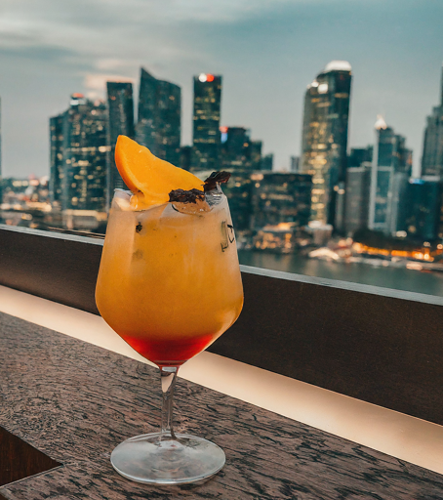
Priority Venues
Deciding 25 venues to start

Slide 13
Priority Venues
Deciding 25 venues to start
What’s important to get customers during the initial phase?
Target Audience Fit
Three Criteria Fit
Potential Reach

Slide 14
Priority Venues
How to decide?
Focus on high-end consumers
Only include F&B venues with that are in
the price_point_bucket ‘$$$’ and ‘$$$$’
Target Audience Fit
A scoring matrix that considers the 3 criteria and Potential Reach to determine top 25 venues
60%
Three Criteria Fit
40%
Potential Reach

Slide 15
Priority Venues
What is Potential Reach?
Potential Reach
Presence of Website
and Phone
Delivery Availability
Review Count
Average Rating
Having a Website and Phone Number means that the venue has multiple avenues to reach its customers and vice versa. (Eg. Customer sees website promotion and phones the venue to ask for more information)
Having a delivery option means the venue would be able to reach a larger crowd. Customers don’t have to physically be at the venue to order to Boozeless spirits and can order it to go.
Having a high review count means that there is certainty in traffic to the venue compared to others and they are willing to give reviews.
Having a higher average rating gives some assurance about the quality of the venue and is a good heuristic in general for anyone who found the restaurant through Google maps
Check against ‘phone’ and ‘website’ columns and create new corresponding columns that indicate 1 if present, 0 if absent
Check against ‘delivery’ key-value pair under ‘amenities’ column and create a new corresponding column that indicate 1 if present, 0 if absent
Check against review_count column and create a new corresponding column that takes the review count and applies logarithmic scaling, then min_max_scaling to range 0 - 1
Check against average_rating column and create a new corresponding column that takes the average rating and applies then min_max_scaling to range 0 - 1

Slide 16
Priority Venues
Scoring Matrix
Young, Mild, Free
20%
60%
Aesthetically Anchored
20%
Three Criteria Fit
Haute Cuisine
20%
Presence of a Phone Number
5%
Presence of a Website
5%
40%
Delivery Availability
10%
Potential Reach
Review Count
10%
Average Rating
10%
100%

Slide 17
Priority Venues
Recommendation of Top 25 Priority Venues

Slide 18
Assumptions
Reality
Information in Google Maps are taken to be true and perfect; any missing information is taken to be difficult to retrieve with reliable accuracy, and hence is to be taken as Nil/ 0 where suitable.
The target market of Boozeless, high-end consumers, is the top criteria to satisfy, and the remaining markets are inconsequential compared to these high-end consumers.
Google Maps data are user volunteered, and hence may result in biases and inaccuracies in data, especially with reviews and ratings
There may be potential for Boozeless to look into differentiated marketing and sales, such that other markets not identified during this analysis could be useful as well.

Slide 19
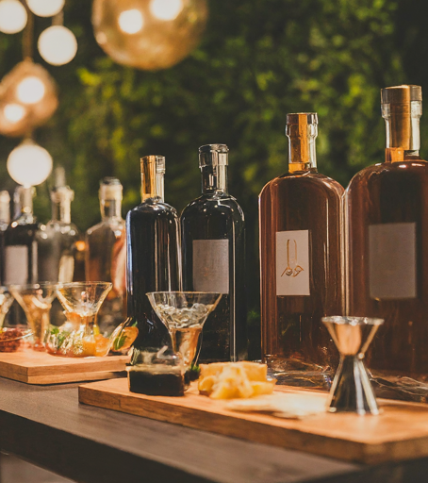
Launch and Marketing of Boozeless in SG
The role of Publicly Available data

Slide 20
Launch and Marketing of Boozeless in SG
The role of Publicly Available data
Market Research & Trends Softwares
Web scrapping competitors
Social Media
Open Sourced Maps
Social Media Presence of F&B venues to decide which venue to launch in
Leverage Social Media of partner venues to publicise Boozeless
Use of trends software such as Google Trends for time-critical information for product/sale strategies (time-based discounts) or market research tools like Statista for macro-economic information
Gain crucial information such as price points (Eg. potential price points its competitors are selling at etc)
Publicly available maps such as URA and OneMap that label the spaces of opportunities Boozeless could use for marketing and launch events that could be close to the F&B venues (Eg. Giving out samples)
Notes:
1. Social Media - Social Media data of the F&B outlets can be scrapped to understand how much social media presence the F&B restaurants have, and how relevant these venues are to Boozeless. As mentioned, the presence of communication methods to customers, such as websites and phone numbers in the dataset are crucial to understand if the F&B Outlets have the appropriate means to reach customers. Likewise, this applies for the availability of the latest social media accounts, such as Facebook, Instagram and TikTok. Boozeless could leverage on the social media and communication means to get to customers.
2. Use of Google Trends to look at what time period is the best for marketing and launch of the product, marketing and sales strategies (Eg. time-based discounts offered, samples to be distributed)
3. Market research tools and competitor web-scrapping to gain an idea of the spirits culture and crucial information such as price points so that Boozeless can understand the potential price points its competitors are selling at etc.
4. Social Heuristics and Maps - Publicly available maps such as the provided one that label the spaces of opportunities Boozeless could use for marketing and launch events that may also be close to the F&B outlets as mentioned above.

Slide 21
Thank you!!
Appendix maybe?

Slide 22
Machine Learning Trial - Predicting whether venue was high-end or not

Slide 23
Goal of ML
To predict the accuracies of data with existing price_point_bucket so that we can fill in the missing values in the column in other rows.
Post Note tldr: It is possible to predict with relative accuracy whether the outlet fit a high-end consumer regular (I.e. 3 $ and more), around 93.7% accuracy*, but due to time constraints, it is not included in the main section.
Future alterations include: Using other models to test, Using the model to predict whether a venue is likely to be high-end.
*Refer to code for more information

